Slide 1
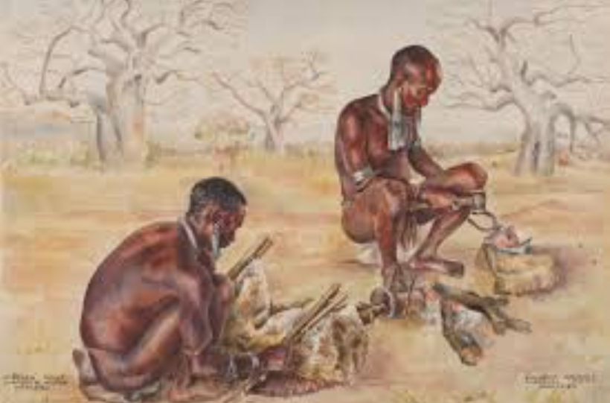
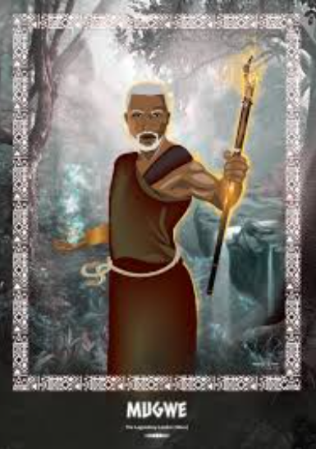
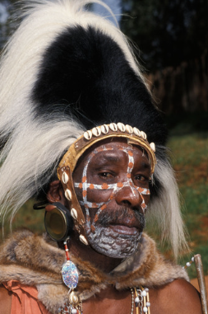
Traditional Medicine in communities
A journey into Indigenous Healing practices of the Kamba , Kikuyu ,and Meru communities.
Kikuyu Healer Kamba Healer Mugwe of the Meru

Slide 2
Introduction
Traditional African medicine is a very important concept and practice .
In my research I decided to major on the kikuyu , Kamba , and meru People who majorly used plants and natural methods to heal.
This herbal practices are still used today in many villages.

Slide 3
The Roles of Traditional Healers
Traditional healers help people who are sick .
They use herbs , prayers and advice to heal .
Some are given different names according to their communities and their abilities such as herbalist and others are diviners.
They are respected in the community.
Many happen to be holding a position in the community such as the village elder.

Slide 4
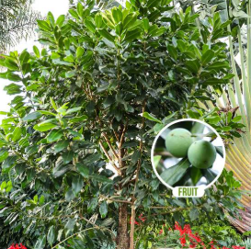
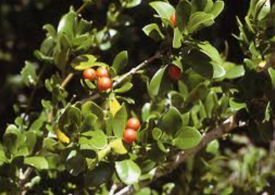
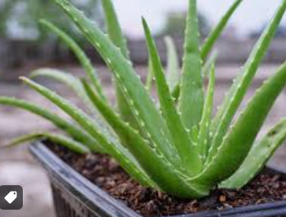
Common Medical Plants
Here are some of the common plants used in healing :
The Warburgia ugandensis – it used for coughs
Strychnos henningsii - used for any stomach complication
Aloe vera - used for open wounds

Slide 5
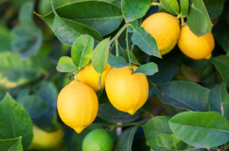
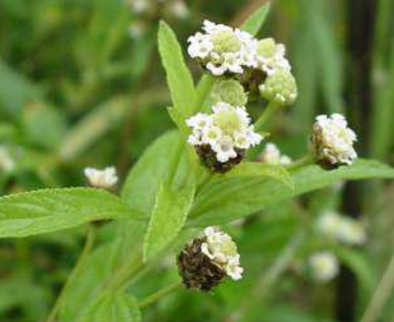
Common medical plants
Ocimum gratissimum (African basil)-for clearing mucus and soothing the throat.
Lippia javanica(lemon bush) – helps with breathing and chest congestions .

Slide 6
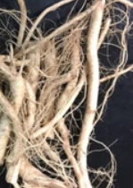
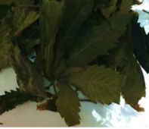
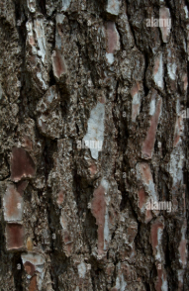
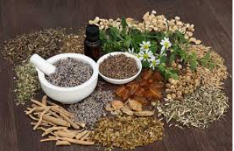
Home Remedies Are Made
Traditional medicine is made:
Leaves, roots, bark, and seeds
They are boiled, crushed, or dried
People drink them as tea or apply them on their skin.

Slide 7
Kikuyu Healing Practices
The kikuyu use herbs to treat many illnesses
The healer is called "Mundu Mugo.“
They treat malaria, stomach pain, and even mental illness.
They also perform rituals and give advice.
They believe illness can be caused by breaking their taboos, which anger their ancestors.
They mostly use herb like Mucatha, Mukoma, and Muthiga to treat problems such as fever, wounds, cough, and chest pain.
The healer may also give blessings or prayers to complete the healing.

Slide 8
Kamba Healing Practices
Kamba people call medicine "miti.“
They are known for trading herbs.
They treat fever, chest pain, and wounds.
Healers also use smoking herbs, rubbing ointments, and steaming with leaves.
One popular method is boiling herbs like Mukomboki and Muviki to treat coughs.
Healers also give guidance and read using bones or nature.
Kamba herbalist pass their knowledge to children and apprentices.

Slide 9
Meru Healing Practices
The Meru also use herbs for healing.
The Njuri Ncheke elders help keep the knowledge.
They use herbs for stomach issues and infections, and spiritual cleansing.
Common herbs include Murembe , Muthiguru, and Katha.
Meru healers often mix herbs with honey or milk.
They also use smoke, songs, and prayers for healing.
The healer may ask the patient to bring soil from their home or hair to help find the cause of illness.
Meru traditional healing is deeply tied to family, nature, and respect for elders.

Slide 10
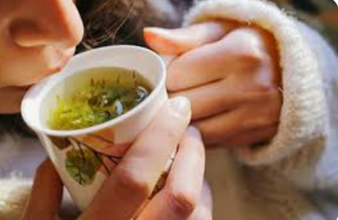
Case Study – Malaria
To treat malaria:
They use a plant called Ajuga remota
It is boiled into tea and given to the sick person
Many people say it works well

Slide 11
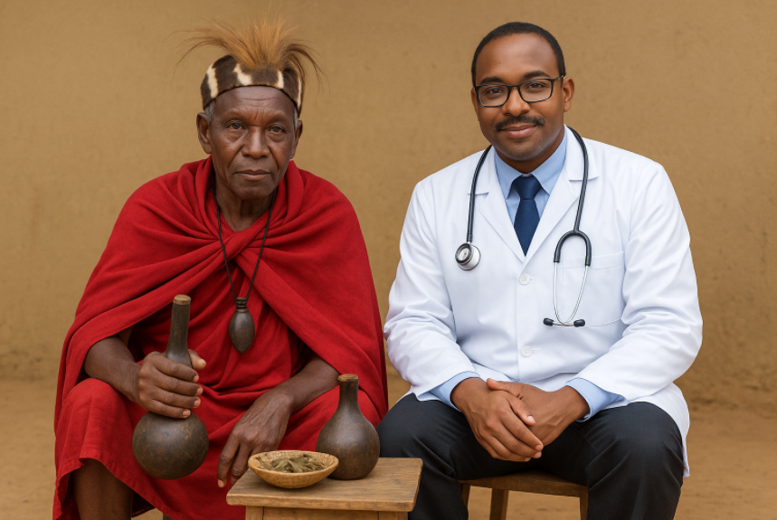
Working with Modern Medicine
Some doctors work with traditional healers.
They learn from each other.
This helps give better care to people.

Slide 12
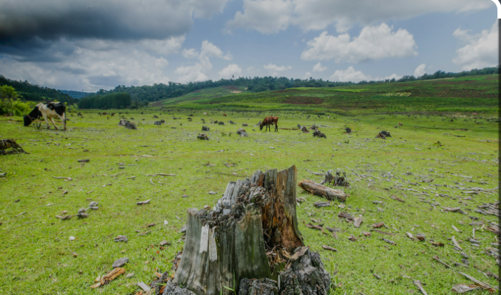
Challenges
Traditional medicine faces problems:
Forests are being cut down
Plants are disappearing
Young people are not learning the knowledge (modernization)

Slide 13
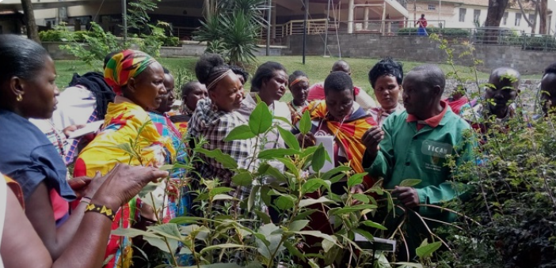
How to Protect It
Communities are helping by:
Teaching young people and helping preserve the nature for herbs.
Writing books about herbs.
Working with schools and health groups.

Slide 14
Real Life Story
My sister had bad chest pain and coughs.
My grandpa (Steve Kamau) a kikuyu, collected a small handful of dried leaves of Warburgia(Muthiga), Ocimum gratissimum, and lemon bush.
He washed the leaves well
Boiled all the herbs together in 2 cups of water for about 15-20 minutes.
He let it cool slightly, then strained.
Added 1 tablespoon of honey to the warm mixture
He then asked her to have half cup in the morning and evening
She drank it for 3 days, and she was fine
She still uses traditional medicine today.

Slide 15
Conclusion
Traditional medicine is important in Kikuyu, Kamba, and Meru communities.
It helps treat many illnesses using herbs and knowledge passed down from elders.
Many people trust these methods and still use them today.
Traditional healers are not only doctors but also counselors and teachers.
They give hope to the community when modern hospitals are far or expensive.
We must support efforts to protect these healing practices.
Let us teach the youth, protect medicinal plants, and work with modern health systems.
By doing this, we keep our culture and health strong.

Slide 16
References
Kenya Forest Research Institute reports
Okebiro, G. (2017). Indigenous Knowledge on Indigenous Plants Used as Medicine or Drugs among the Abagusii for Sustainable Human Life. Available at SSRN 3087066.
Sindiga, Isaac, et al. "Kikuyu traditional medicine." Traditional Medicine in Africa (1995): 129-139.

